Slide 1

Lab Experiment Course
Design and Implementation of Wireless IoT Sensors
Yuguang Fu
Nanyang Technological University
29-July, 14:00 - 17:15 @ TU103 & ZS1107

Slide 2

Instructions Link
https://drive.google.com/file/d/1CTkIzI5p-hHYY3L5tGsbDlZzlYgO4l7S/view?usp=sharing

Slide 3
Objective
🎯Assemble an IoT wireless sensor
🎯Configure, compile and upload the code
🎯Deploy sensors for vibration testing

Slide 4
Section I - Introduction

Slide 5
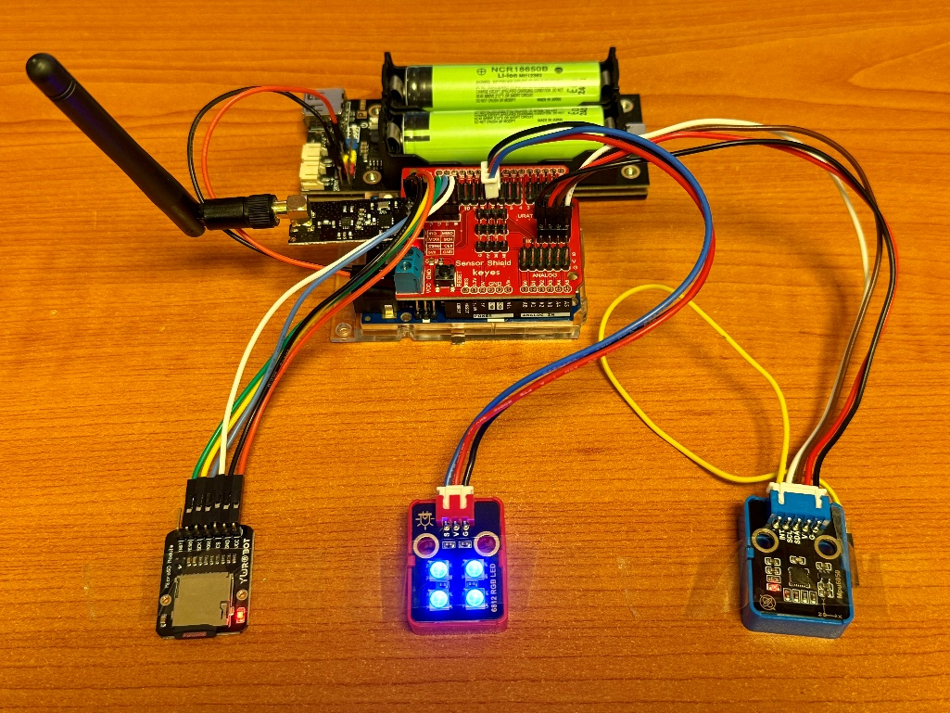
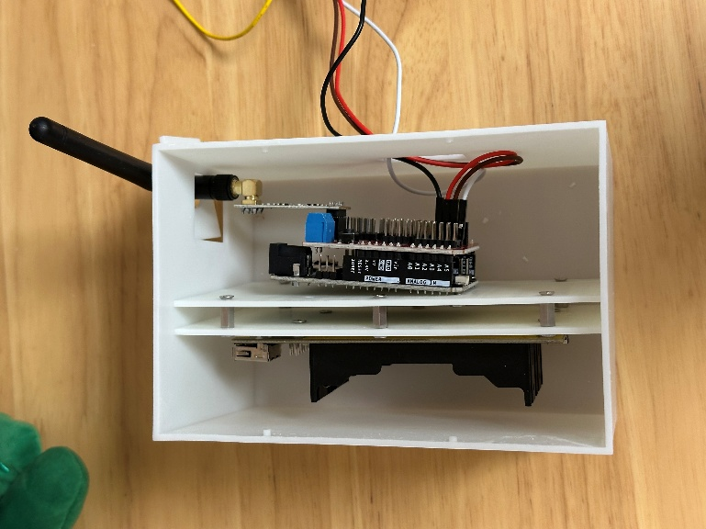
Hardware Setup
Preview of the Assembled IoT Wireless Sensor
NRF24L01 & Antenna
Battery
Battery holder
Enclosure
Sensor Shield
Arduino UNO R4 WIFI
SD Card
RGB LED
MPU6050

Slide 6
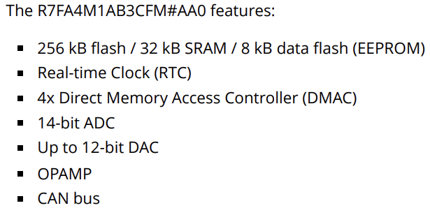
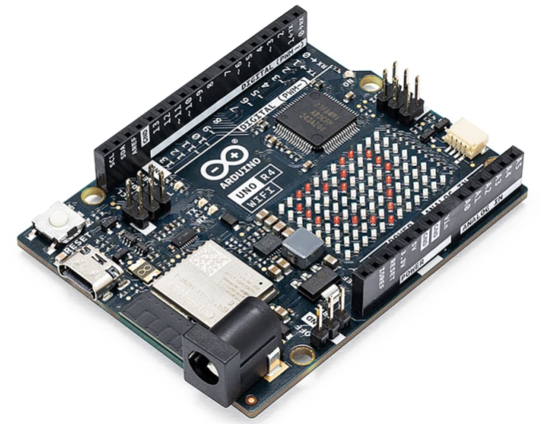
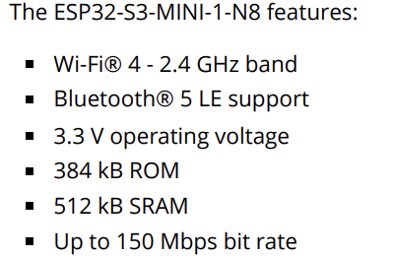
Hardware Setup
Main Controller Board (Arduino Uno R4 WIFI)
Microcontroller
Wi-Fi Module

Slide 7
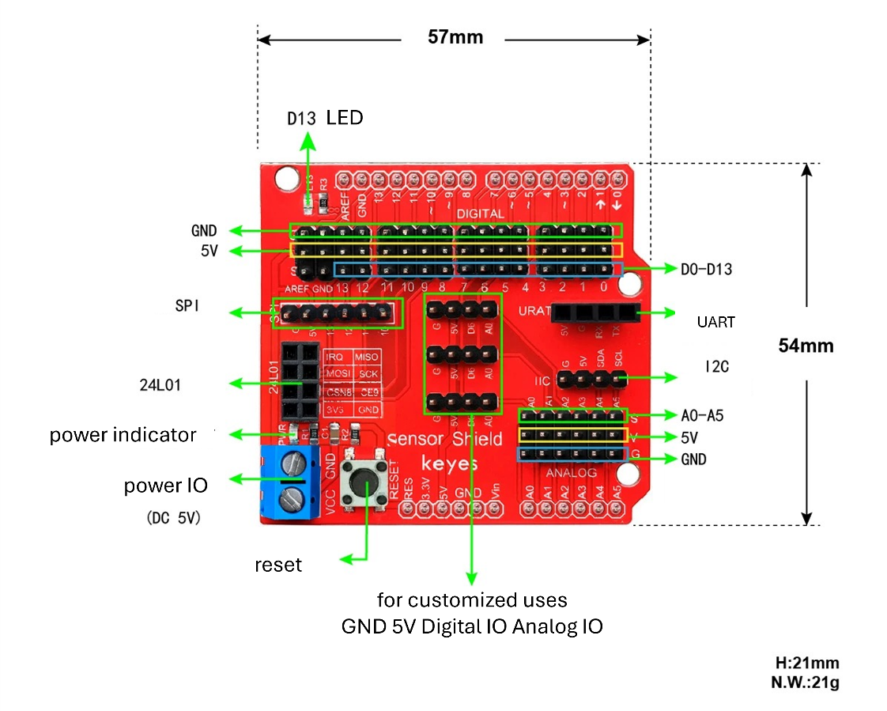
Hardware Setup
Sensor Shield
An expansion board designed for connecting various sensors and other components to an Arduino board, providing a rich set of interfaces to facilitate wiring.

Slide 8
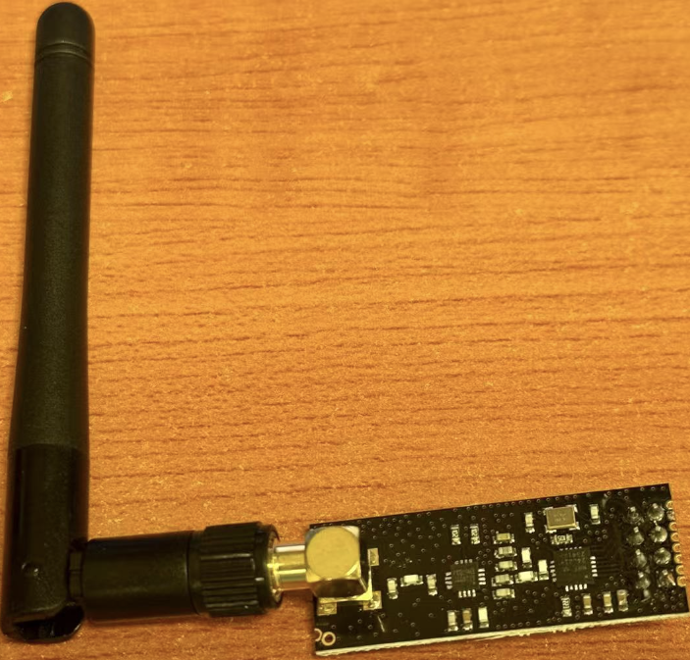
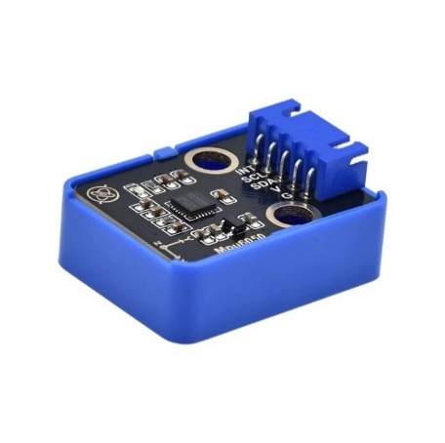
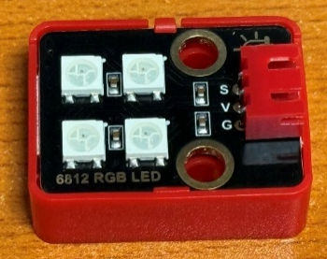
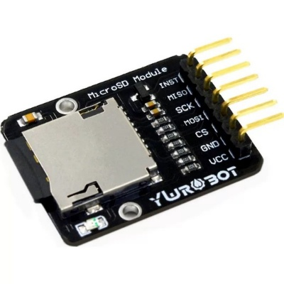
Hardware Setup
Accelerometer & Radio Frequency & RGB LED & SD Card
MPU6050
Frequency radio module (nRF24L01)
an inertial measurement unit (IMU) that integrates a 3-axis gyroscope and a 3-axis accelerometer
2g/4g/8g/16g
16 bit
low-power, low-cost 2.4GHz wireless transceiver
short-range wireless communication
250 kbps/1 Mbps/2 Mbps
RGB LED
consists of three independent LEDs that emit red, green, and blue light
various colors can be generated by mixing red, green, and blue
SD Card module
an external storage device used for data storage
communicates with Arduino via the SPI interface

Slide 9
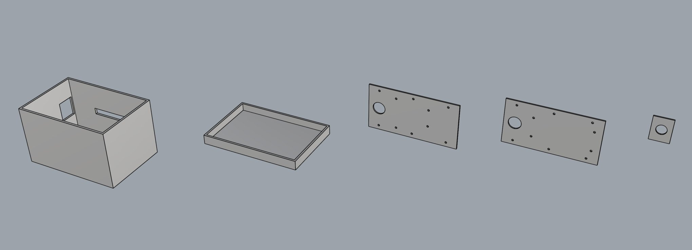
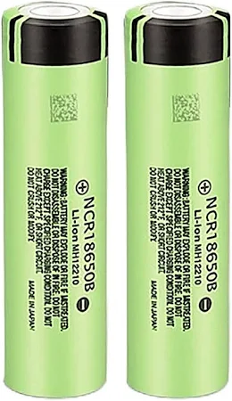
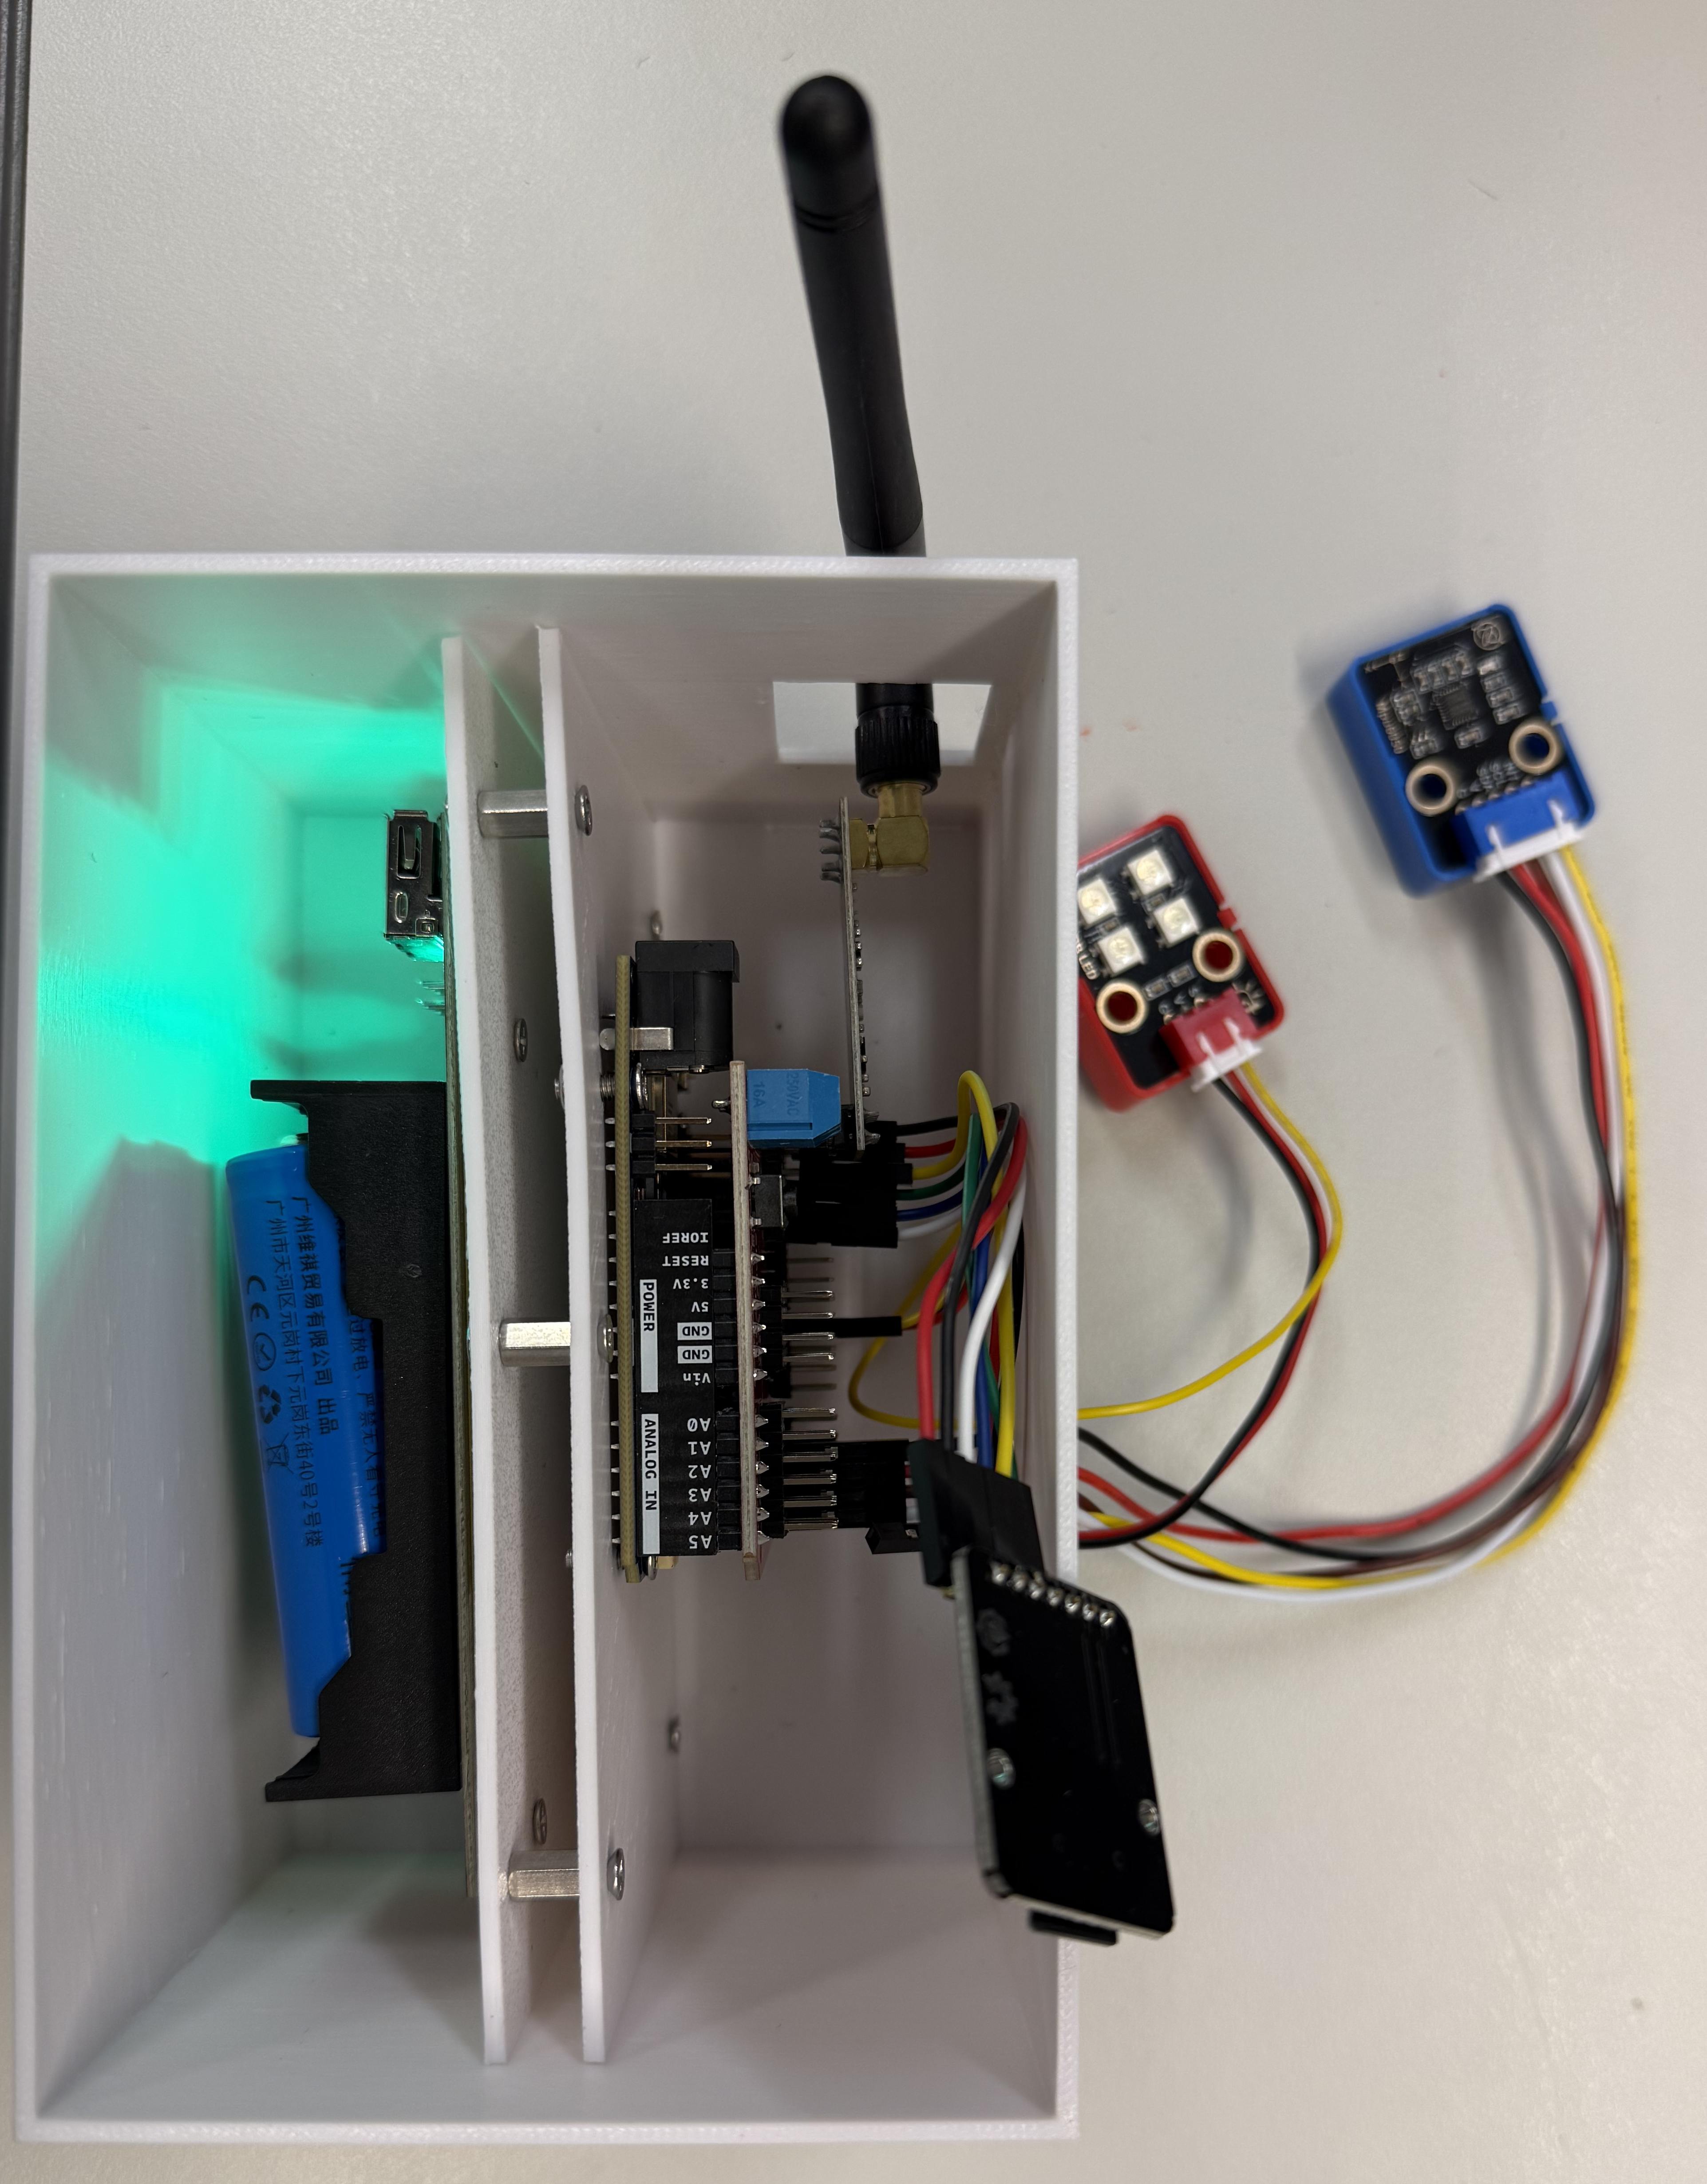
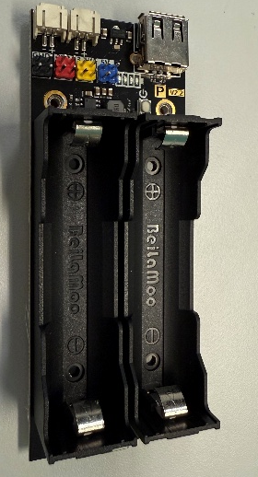
Hardware Setup
Power Supply & Enclosure
Lithium batteries
Enclosure
two 18650 lithium batteries
rechargeable, high energy density
output voltage: 3.7V
battery capacity: 3400mAh
Battery holder
accommodate two 18650 lithium batteries
provide necessary connection interface

Slide 10
Embedded Programming
Development Framework
I Setup + Loop
II State Machine
III Front End & Back End
The ‘Setup + Loop’ structure forms the foundation of Arduino development. It embodies the widely adopted “initialization + infinite loop” paradigm used across most embedded systems.
By using a state machine, users can effectively separate the internal logic of each state from the transitions between states.
With a front-end and back-end architecture, the embedded system can support event-driven programming, which is highly beneficial for many applications.
Setup
state1
Front
Back
Loop
state2
state3

Slide 11
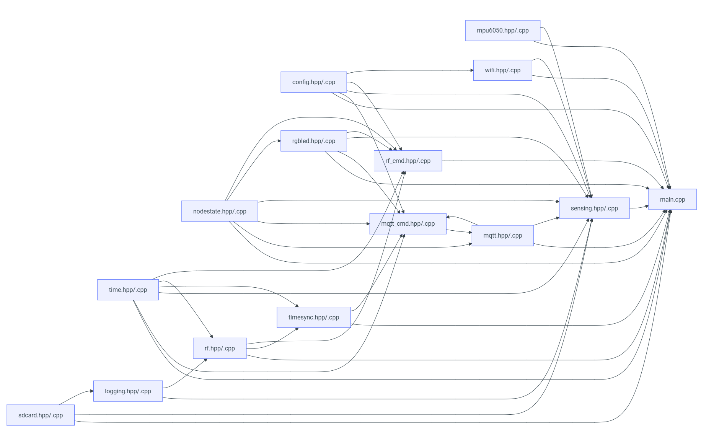
Embedded Programming
Software Architecture
Modularized
Hierarchical
config & state
Communication
sensing
feedback
time
storage

Slide 12
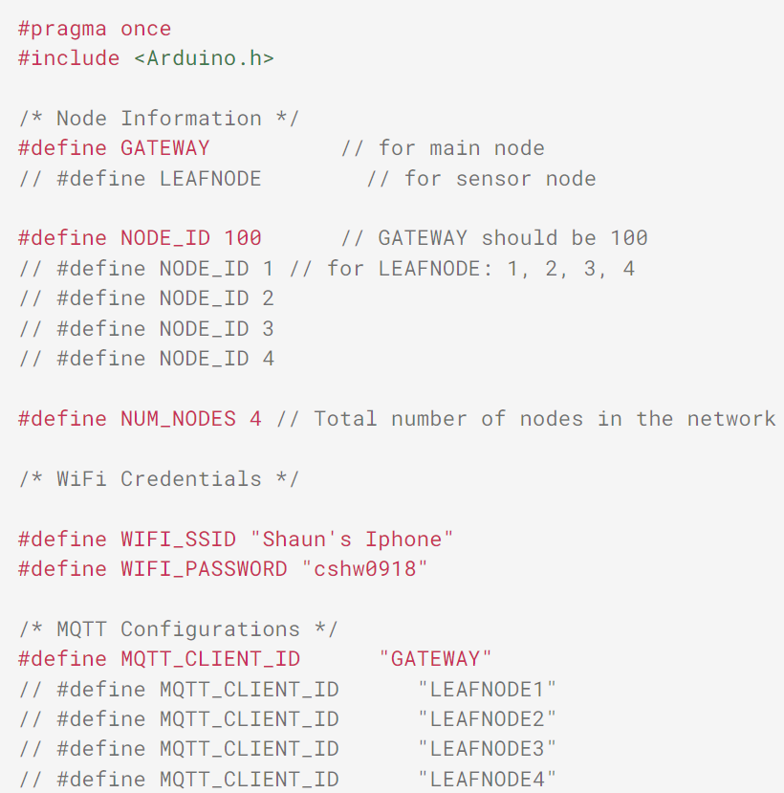
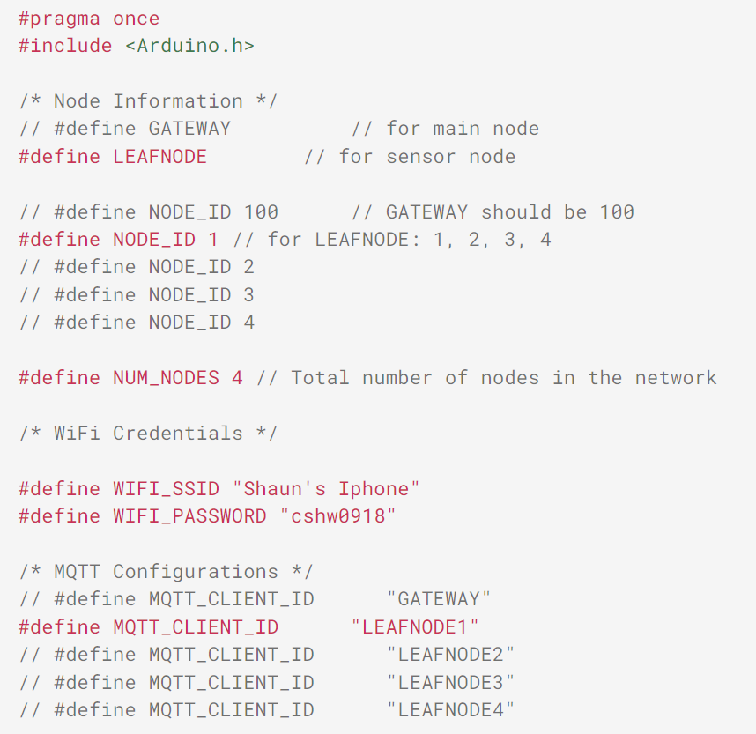
Embedded Programming
Configuration
To facilitate the configuration of the software, a configuration file is provided for modification as needed.
GATEWAY NODE EXAMPLE
LEAFNODE EXAMPLE
Handson – TASK 1
…
…

Slide 13
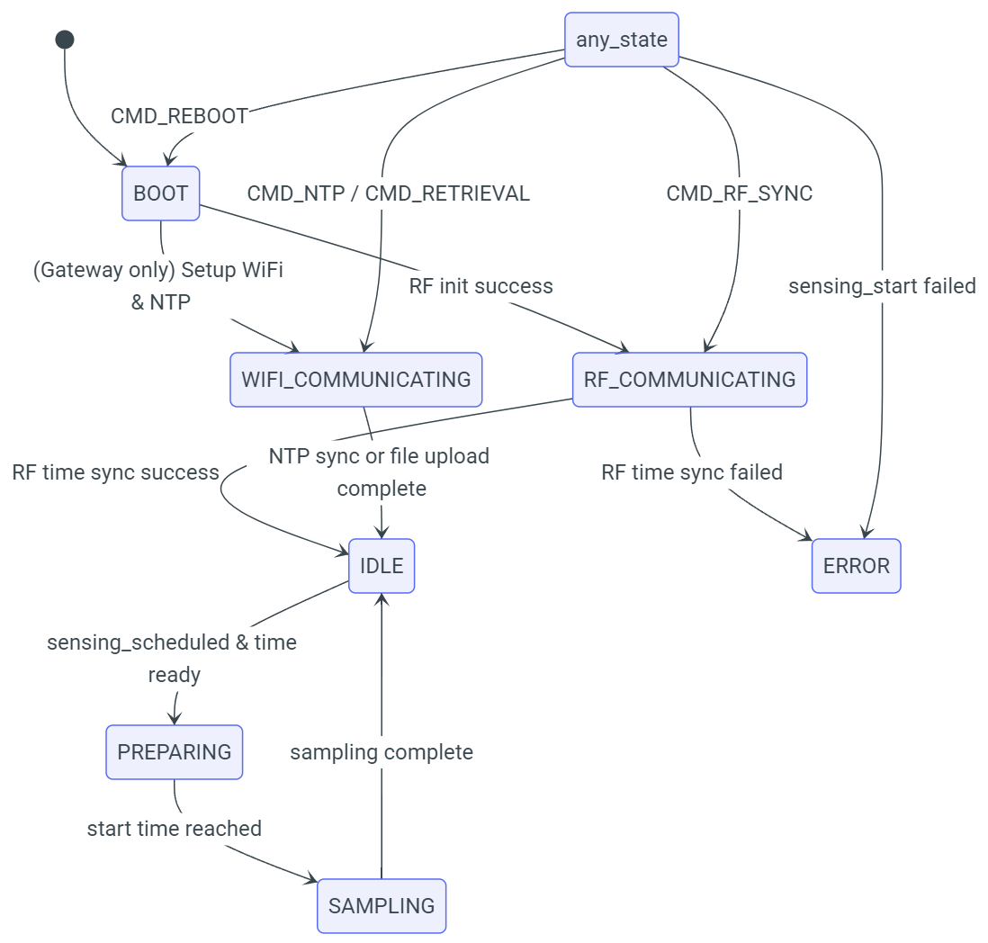
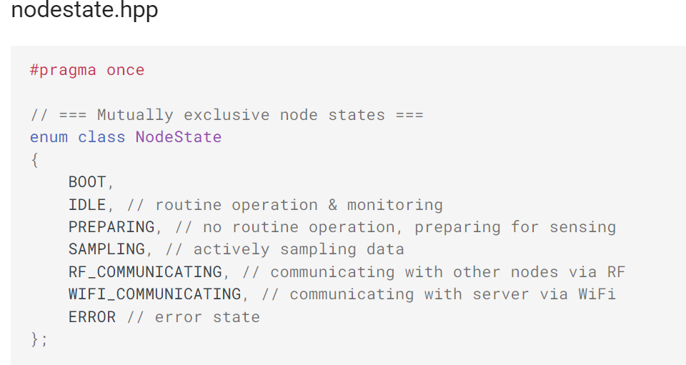
Embedded Programming
State Machine and Indicators
Without the introduction of a real-time operating system, a state machine is a common method for implementing complex logic. It manages system behavior by defining states and transitions between states.
State Transition Map

Slide 14
Embedded Programming
Communication
Internet Comm. - WIFI
Local Comm. – Radio Frequency
In this project, we use the onboard WIFI module to connect to the Internet, which is the foundation for NTP time synchronization and MQTT remote command control.
RF communication refers to the technology of transmitting information through radio waves. It is widely used in radio, television, mobile phones, satellite communications and other fields. The basic principle of RF communication is to modulate information onto RF signals and transmit and receive them through antennas. This project uses nRF24L01 wireless module for RF communication.
Internet Comm. - MQTT
Message Queuing Telemetry Transport (MQTT) is a lightweight messaging protocol designed for low-bandwidth, high-latency, or unreliable networks. It is commonly used for communication between Internet of Things (IoT) devices.

Slide 15
Embedded Programming
Time
Time Synchronization
Natural Timekeeping – for human
Global Time Sync - NTP
Natural timekeeping refers to using calendar and clock formats familiar to humans to represent time. This usually includes fields such as year, month, day, hour, minute, and second.
NTP (Network Time Protocol) is used to synchronize local device time with an accurate time source on the internet.
Unix Time – for machine
Local Time Sync - FTSP
Unix time refers to the number of seconds that have elapsed since January 1, 1970, 00:00:00 UTC. It is a standard time representation widely used in computer systems. The advantage of Unix time is that it is easy to compute and compare, although it is not easily readable by humans.
This project implements a flooding-based time synchronization protocol (FTSP), where the gateway node periodically broadcasts its current time to all leaf nodes. Each leaf node receives the messages and calculates timing offset and clock drift to align its local time accordingly.
Runtime – for local timetracking
Runtime refers to the duration from system startup to the current moment, usually measured in milliseconds. It is particularly important in real-time systems and embedded devices, as it helps monitor system status and performance. Most hardware platforms provide a timer to track runtime.

Slide 16
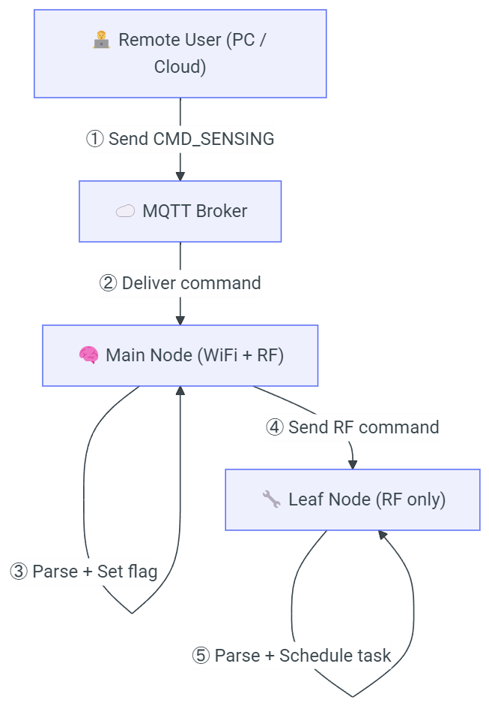
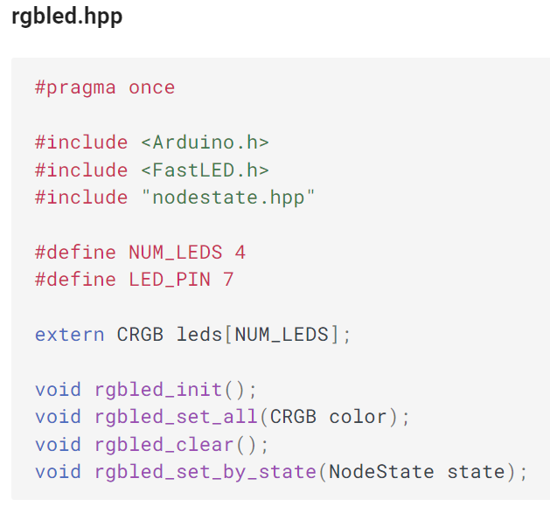
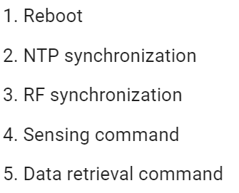
Embedded Programming
Command
Feedback - RGBLED
In this project, we achieve node control over the internet based on the MQTT callback mechanism.
Associate with the state machine, different states are indicated by different colors of the RGBLED.

Slide 17
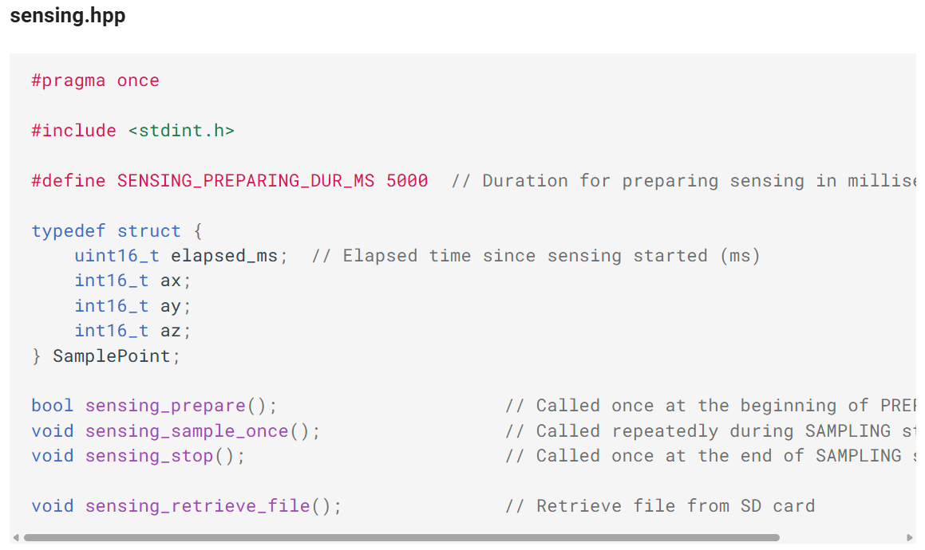
Embedded Programming
Acceleration Sensing, Storage, and Upload
Since Arduino performance is very limited, this project uses a method of sampling and storing at the same time to achieve data collection.
Since there is no real-time operating system, the storage process will have a certain impact on sampling, so a high sampling frequency cannot be achieved. The highest sampling rate in this project is 250Hz.
Handson – TASK 2

Slide 18
Section II – Hands On

Slide 19
TIP: This is a team effort — please work together with your teammates to speed up the process.

Slide 20
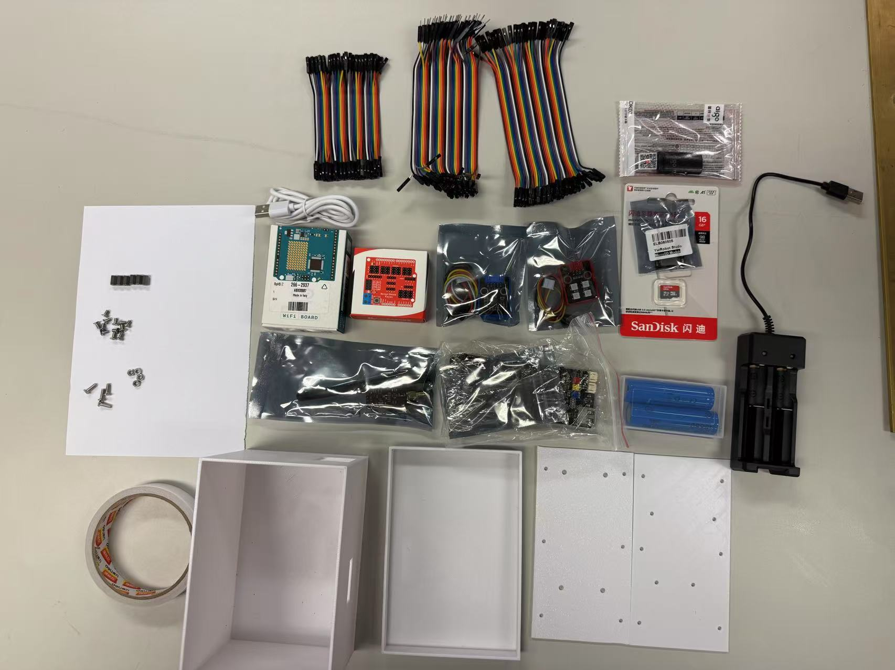
🪒Hardware Setup
What is in the bag?
Contact the helper if any component is missing

Slide 21
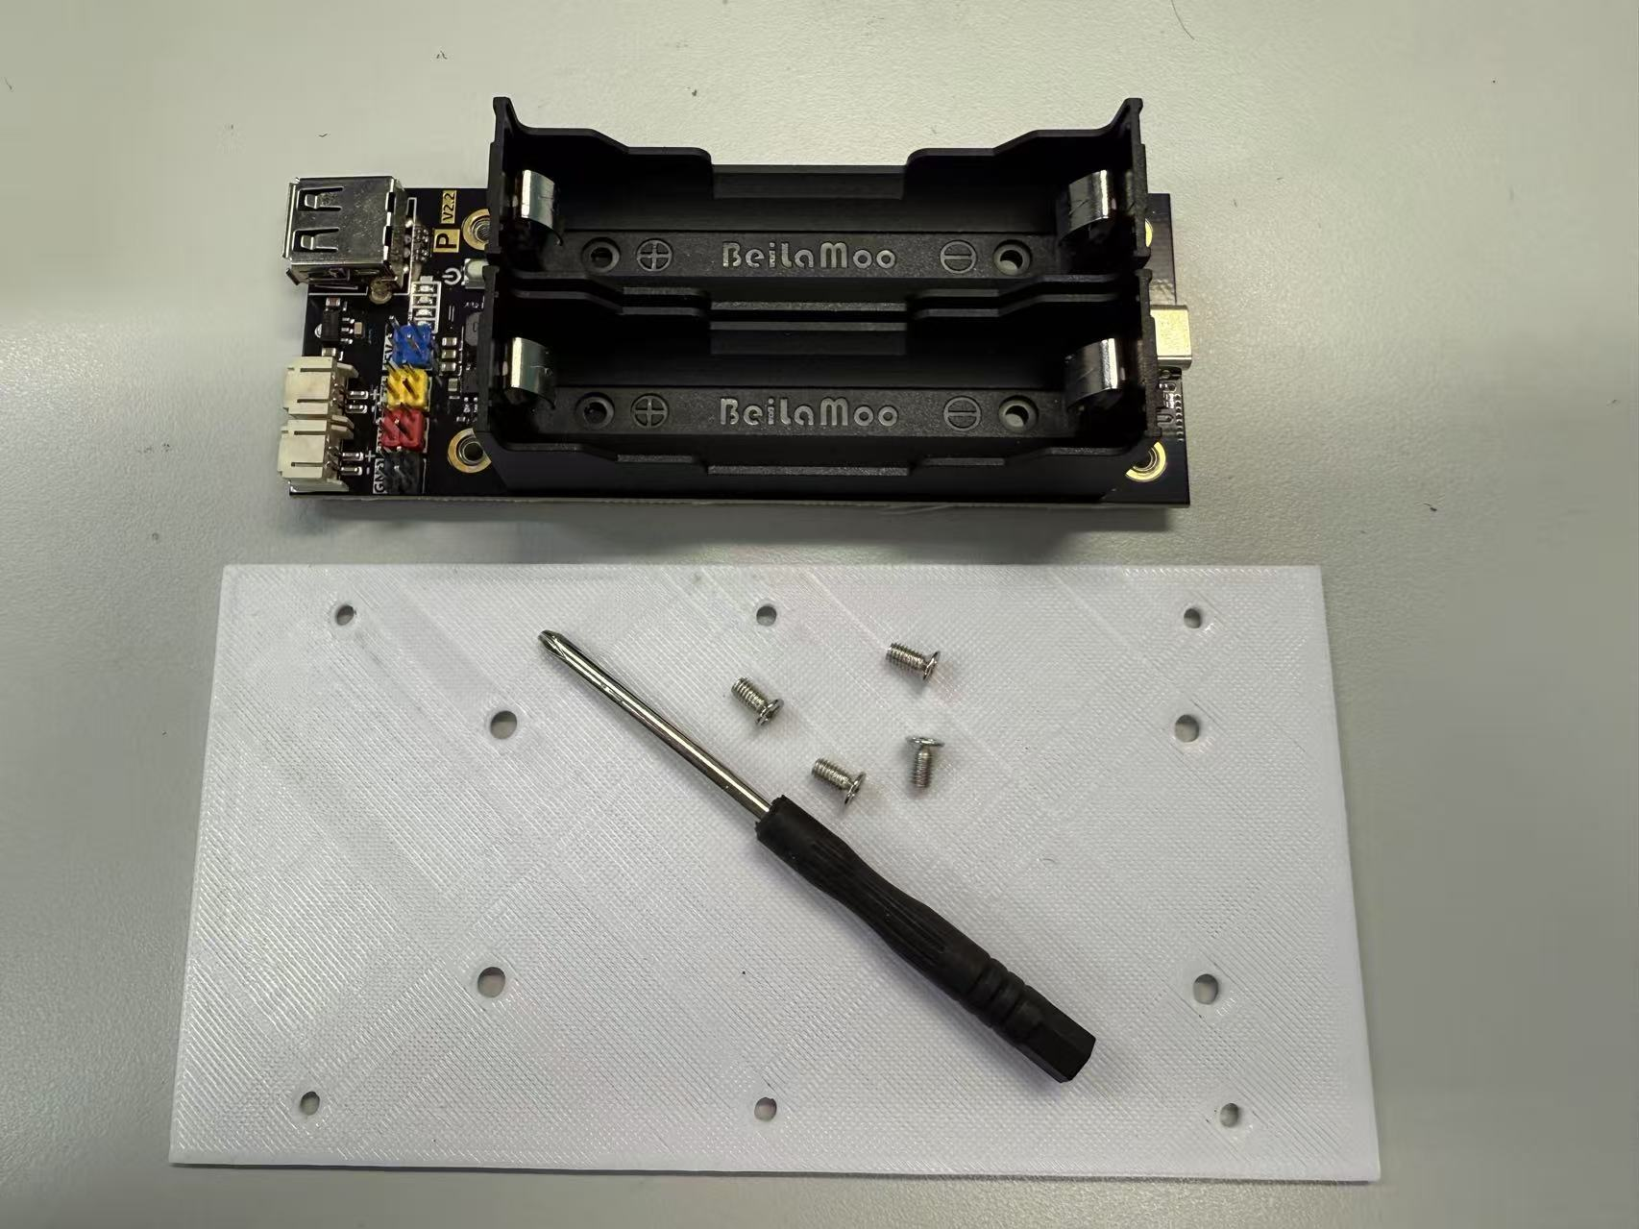
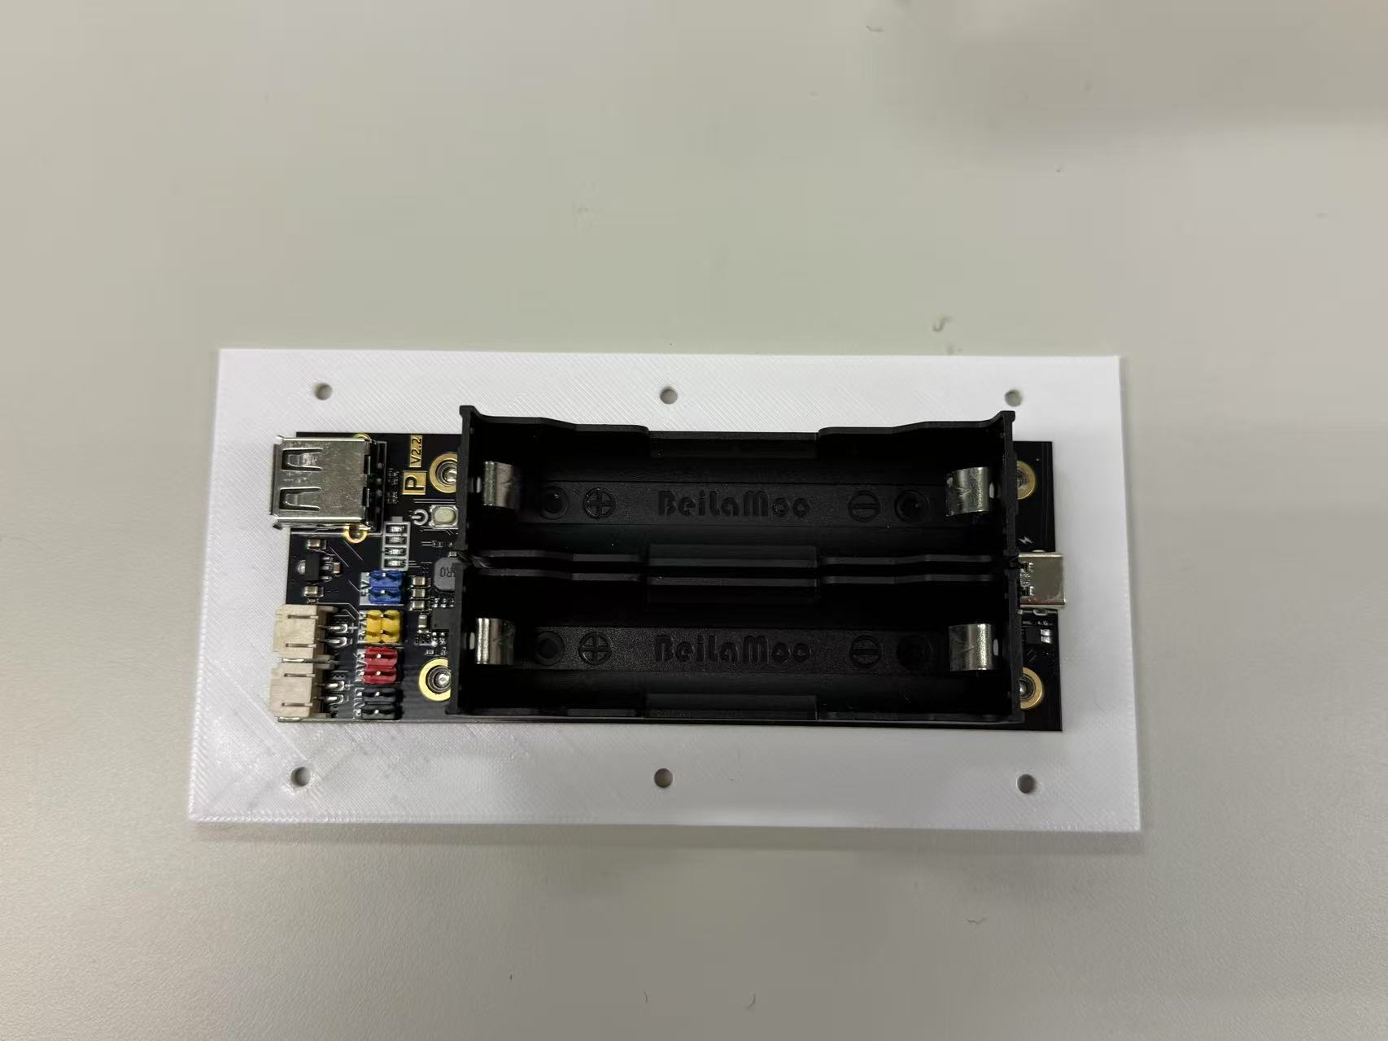
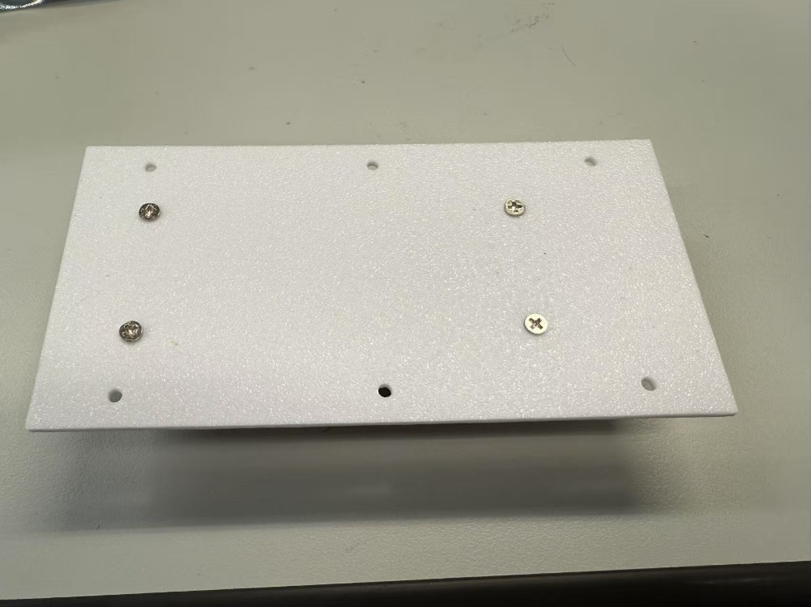
🪒Hardware Setup
1 Battery Box Installation
Please ensure the orientation is correct
screws from this side
from the battery holder package

Slide 22
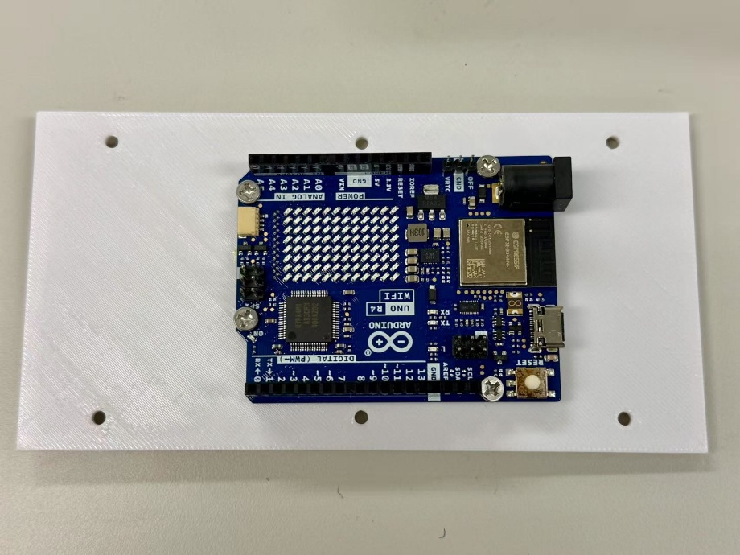
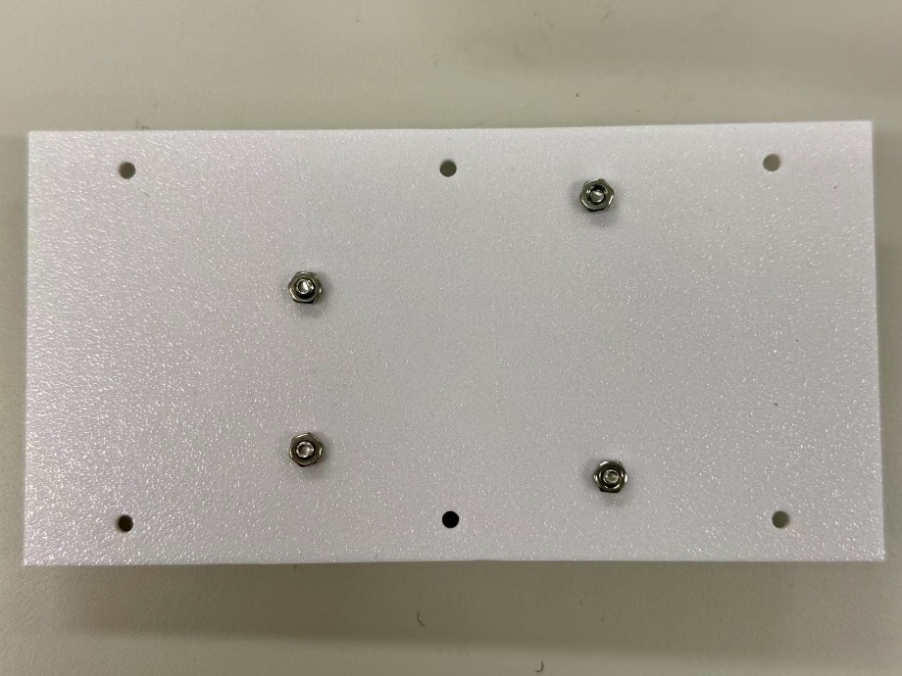
🪒Hardware Setup
2 Main Controller Board Installation
M3*10
nuts from this side
screws from this side
Please ensure the orientation is correct

Slide 23
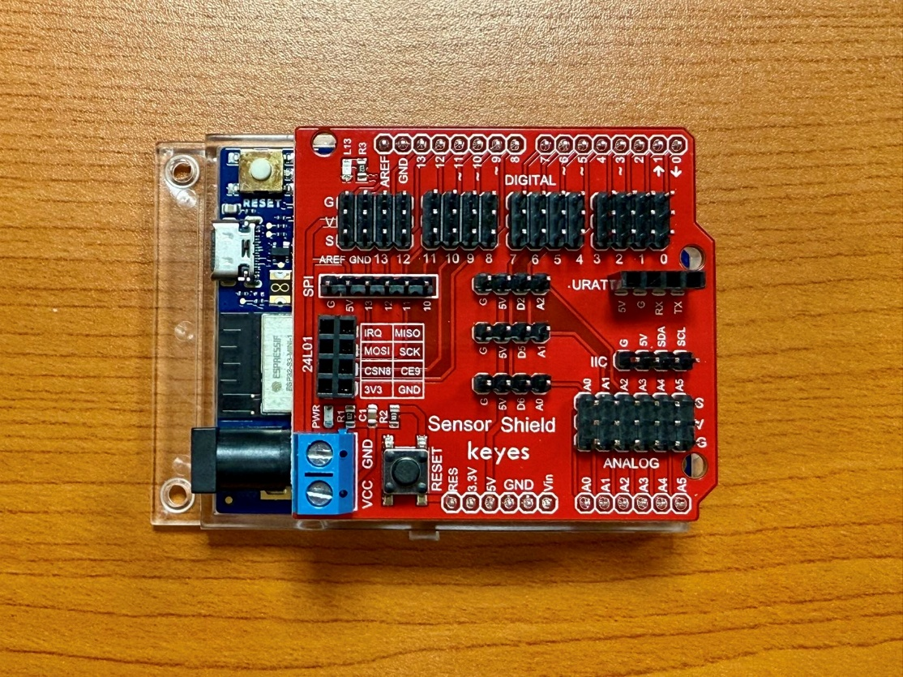
🪒Hardware Setup
3 Extension Board (Sensor Shield) Installation
Please make sure the pins are correctly connected.

Slide 24
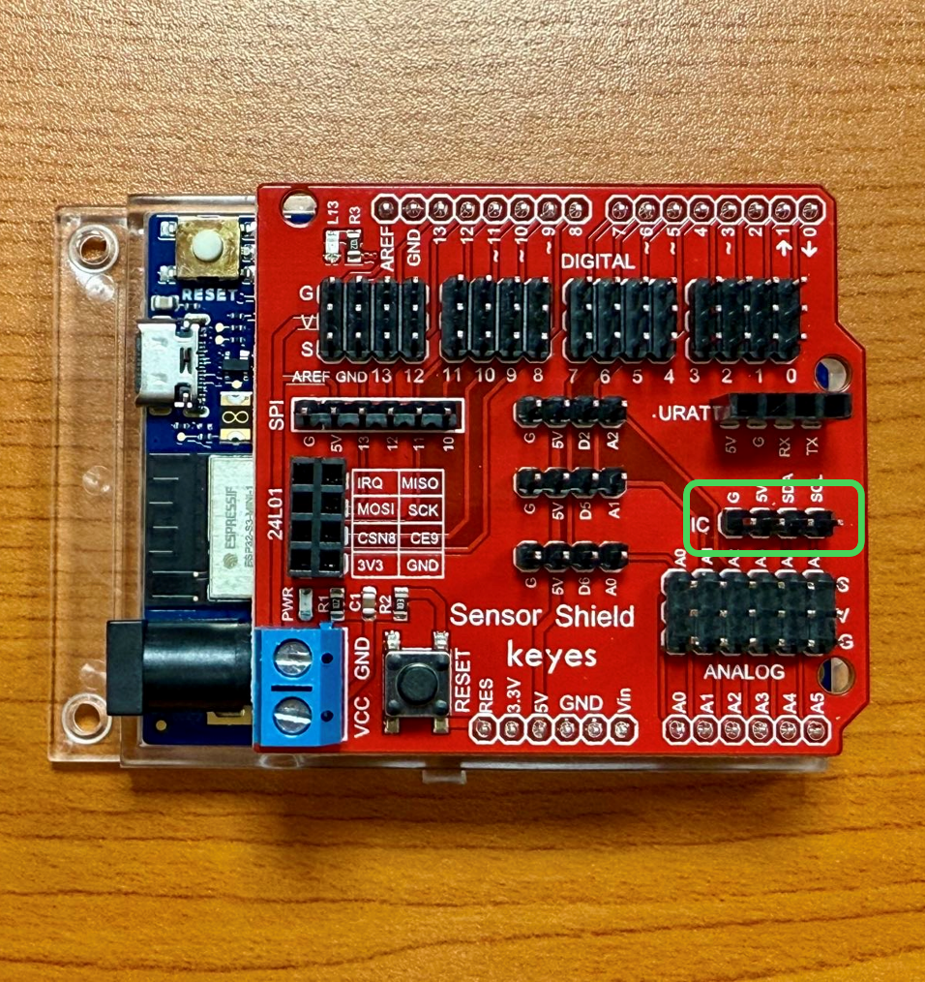

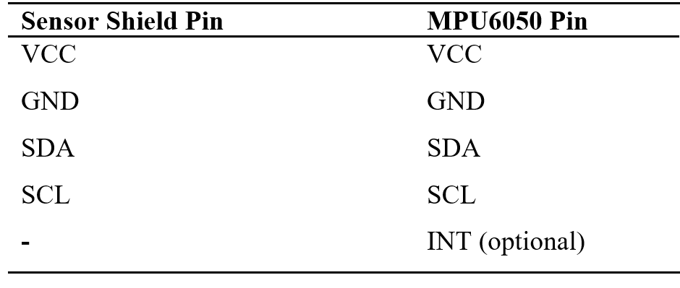
🪒Hardware Setup
4 MPU6050 Installation
G
G
5V
V
(not used)
Please make sure the pins are correctly connected. INT can be left unconnected.

Slide 25
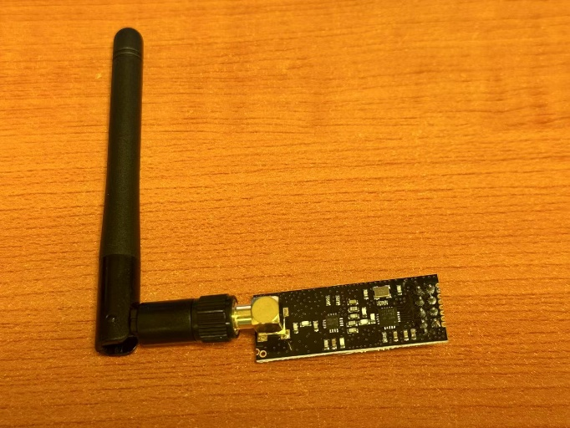

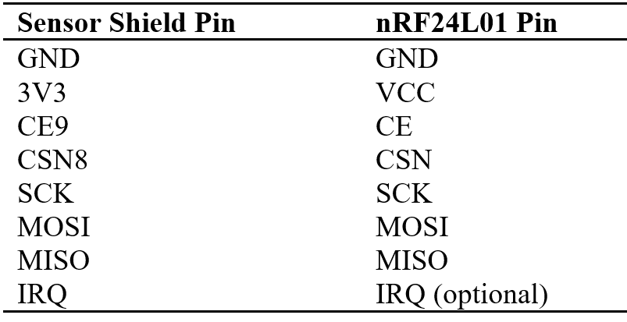
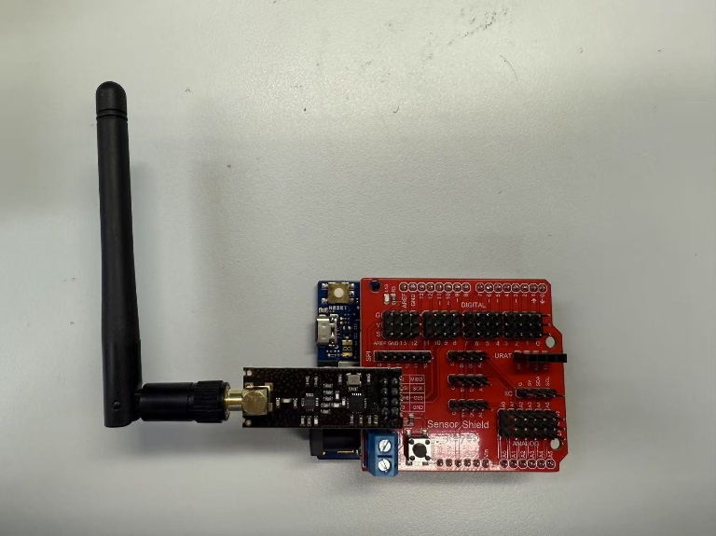
🪒Hardware Setup
5 Radio Frequency Module Installation
You can just attach the RF module onto the sensor board like this.

Slide 26


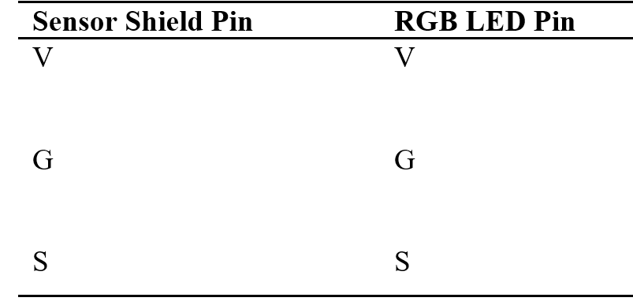
🪒Hardware Setup
Use the associated wires in RGBLED package.
6 RGBLED Installation
G
G
V
V
Please connect to the pins corresponding to digital 7.

Slide 27
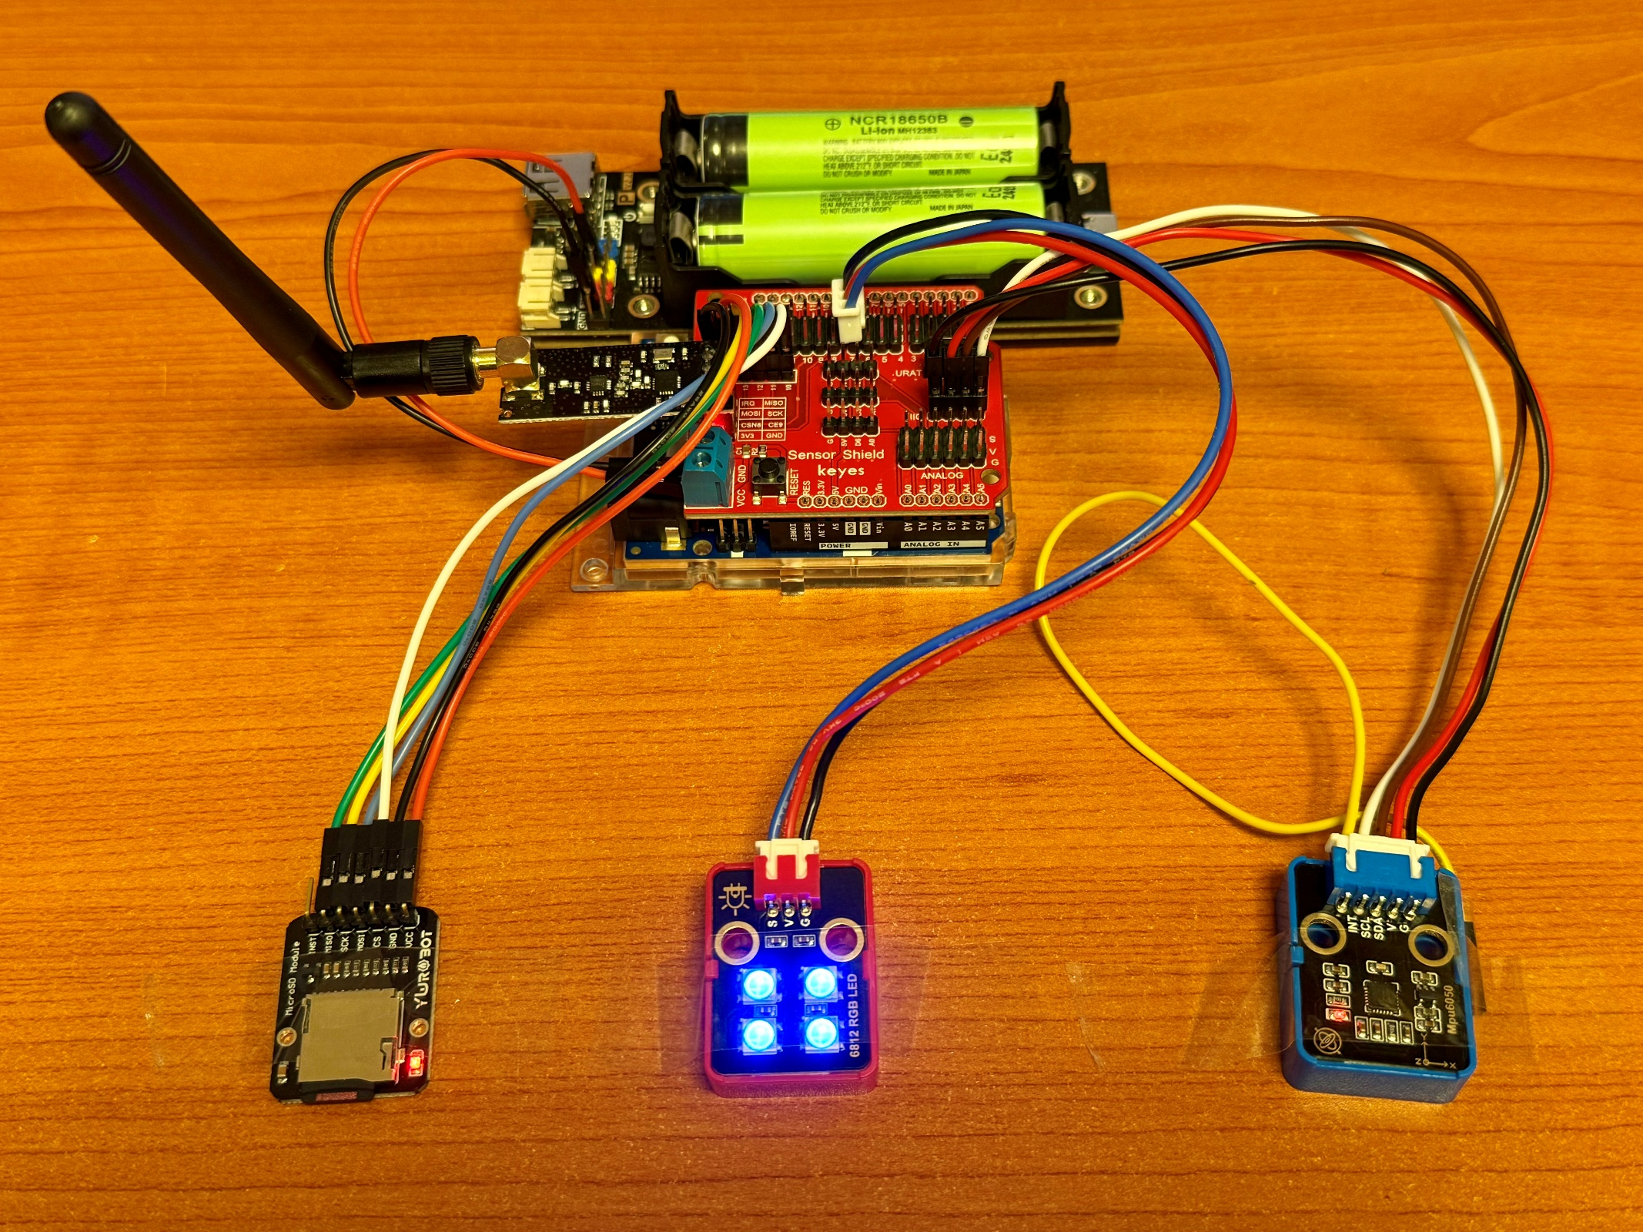


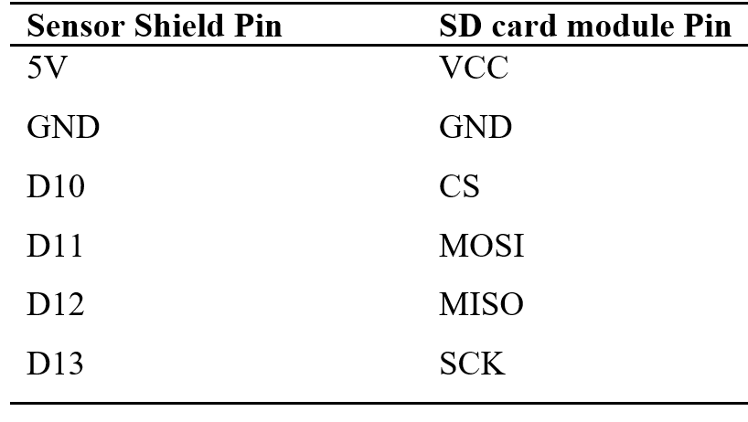
🪒Hardware Setup
Please make sure the pins are correctly connected. Don’t forget to insert a SD card.
7 SD Card Module Installation
Recommended Dupont Wire Color

Slide 28
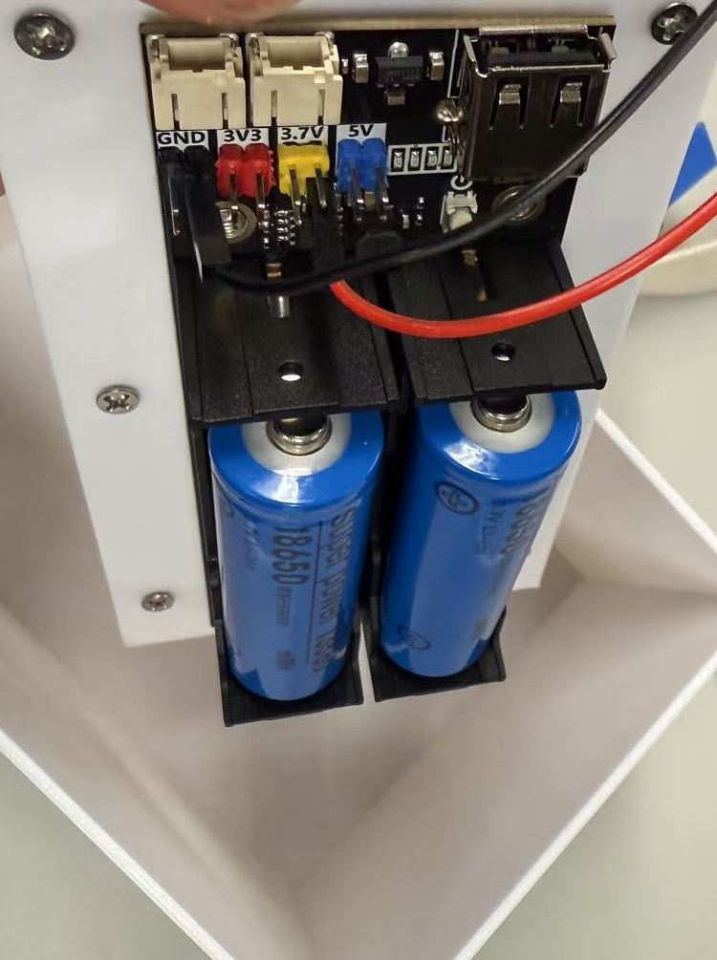
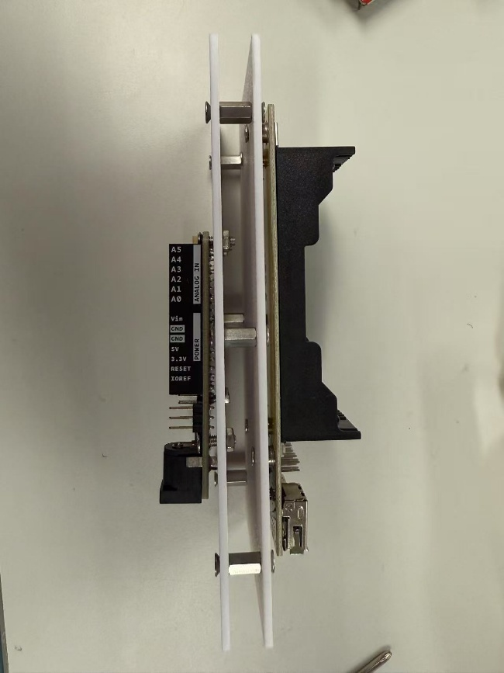
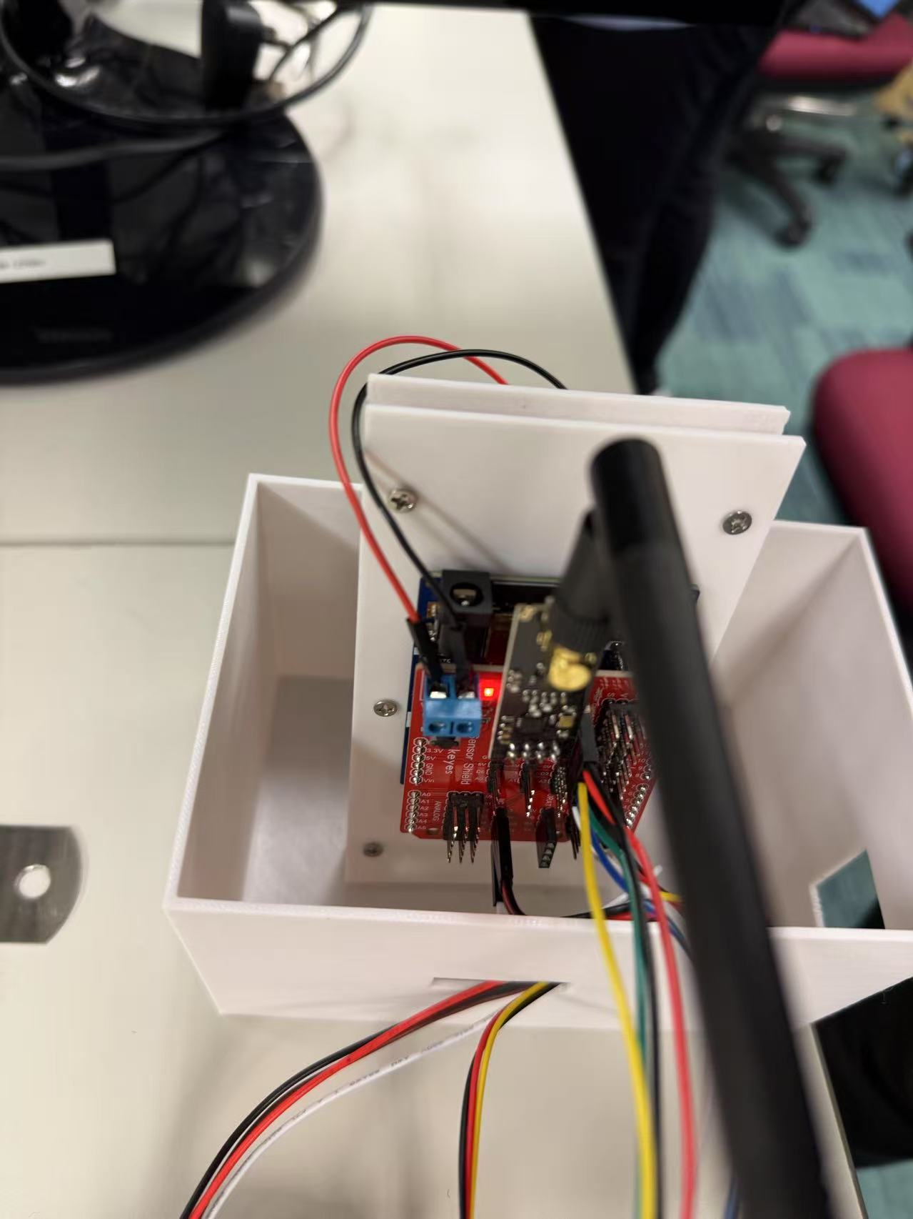
🪒Hardware Setup
8 Enclosure Assembly – Better do this after programming
Connecting the two mounting boards by standoff and screws.
M3*6
M3*6
Power Supply over two wires.
Batteries can not be fully inside.
Carefully check all connections, then approach to the helpers for this step before powering up the board.
Wires: GND and 3.7V

Slide 29
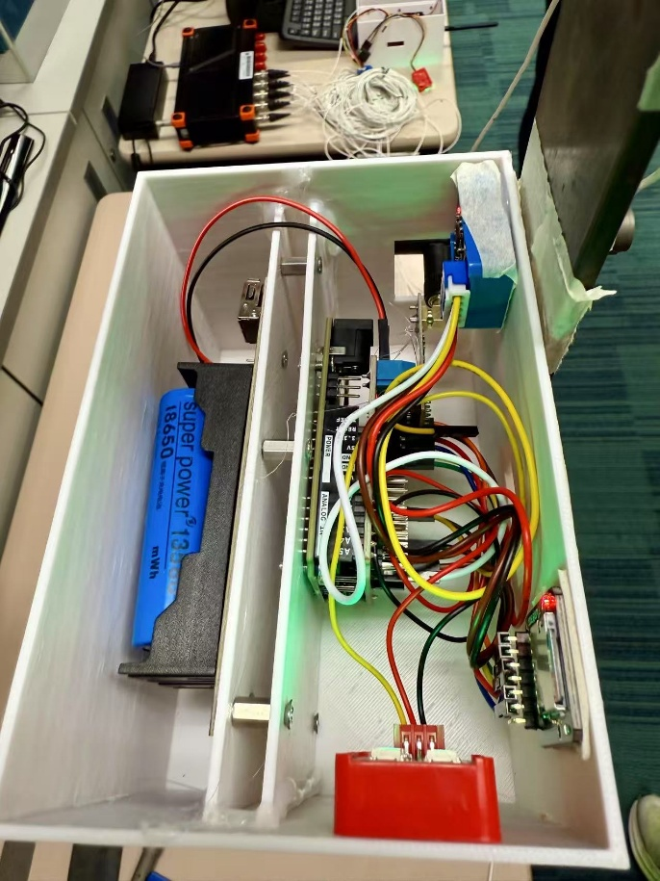
🪒Hardware Setup
8 Enclosure Assembly
You don’t need to use glue.
Fixing component to better serve its purpose in different use cases.
Before you power up your devices using batteries, better let our helpers to check for you incase it burns.

Slide 30
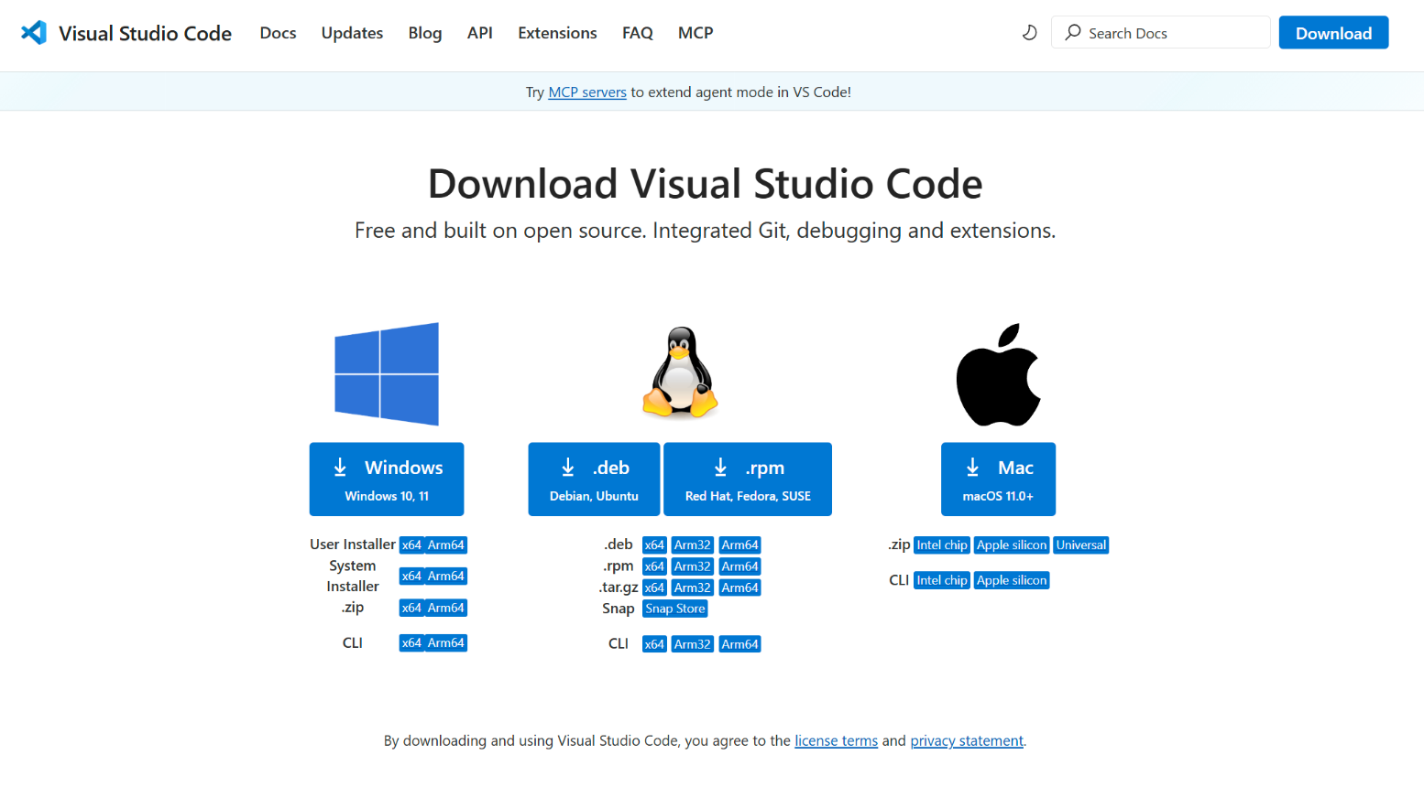
🪒Embedded Programming
1 Preparation – 1 IDE
Install VS Code https://code.visualstudio.com/download

Slide 31
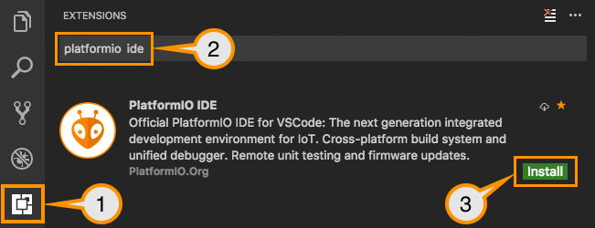
🪒Embedded Programming
1 Preparation – 2 Platformio
Install PlatformIO for programming

Slide 32
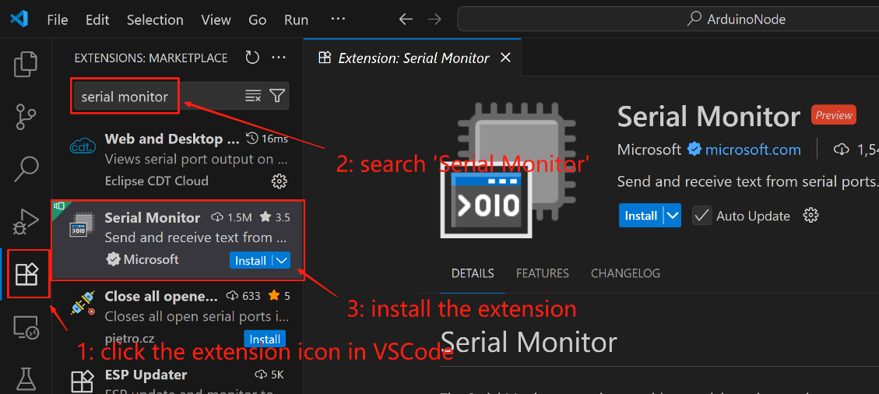
🪒Embedded Programming
1 Preparation – 3 Serial Monitor
Install Serial Monitor for serial monitoring

Slide 33

🪒Embedded Programming
1 Preparation – 4 Download Source Code
Google Drive Link
https://drive.google.com/file/d/1a3NcdvuK-aEz1CZiBiajPYCWUiWINM_Y/view?usp=sharing

Slide 34
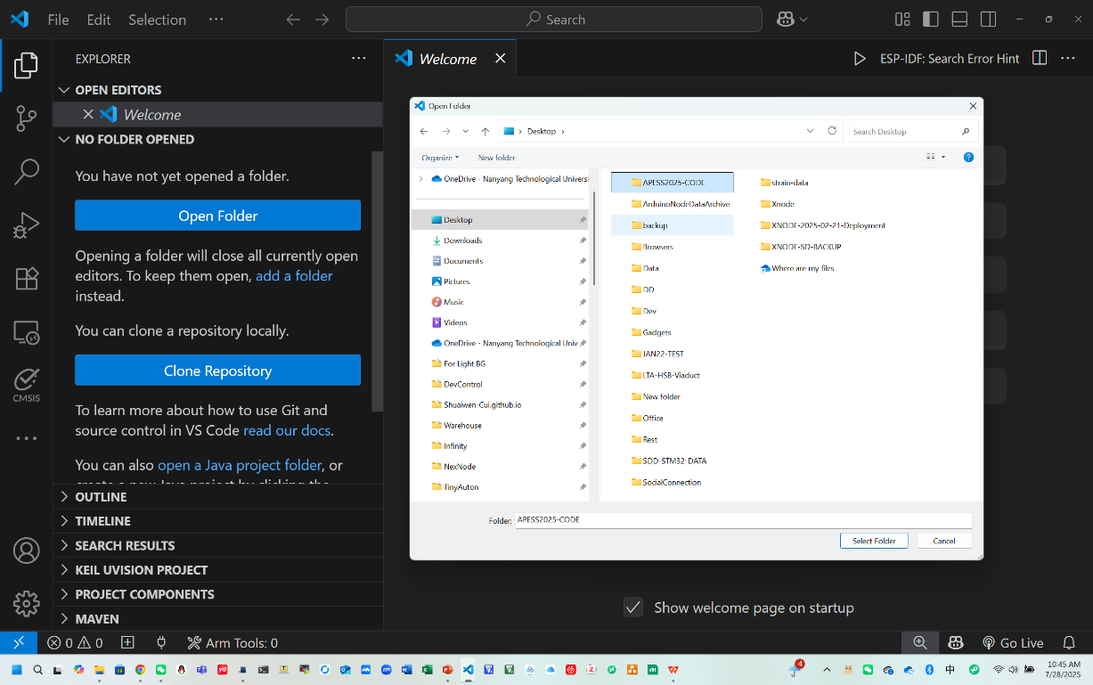
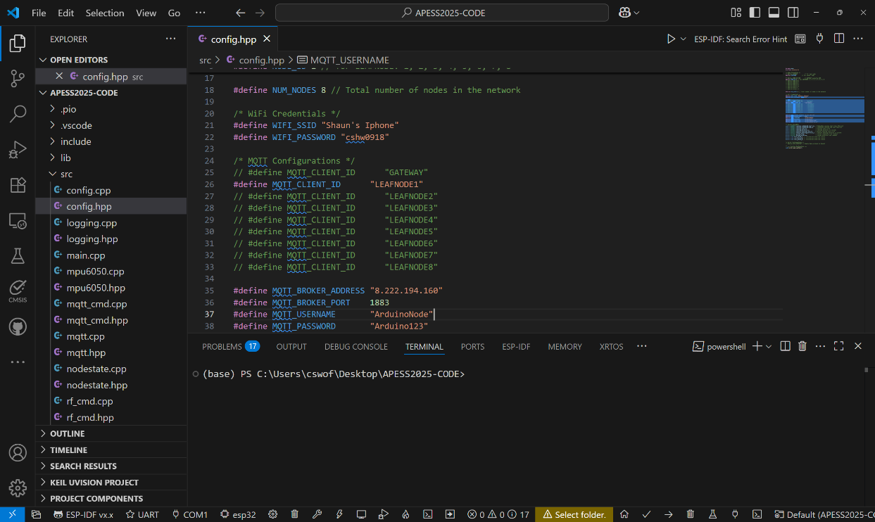
🪒Embedded Programming
2 Programming –Open the downloaded project
Step 1: Launch VSCode
Step 2: Open the folder where you extract the project code.
Step 3: Ensure the Platformio environment is activated. Simply double click a code file.

Slide 35
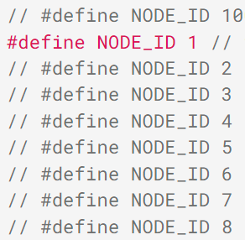
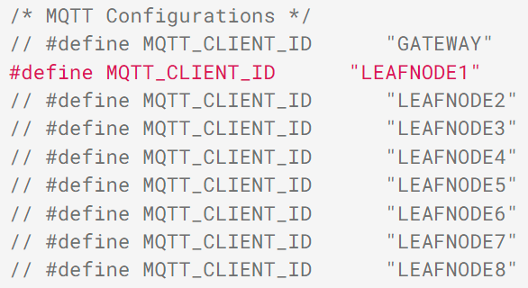
🪒Embedded Programming
2 Programming – TASK 1 Modify the Configuration File
Step 1: Navigate to the ‘src’ folder, double click the ‘config.hpp’.
Step 2: Modify the ‘NODE_ID’ and ‘MQTT_CLIENT_ID’ to the one corresponding to your group number. For example, group 1 Please use NODE_ID 1 and MQTT_CLIENT_ID “LEAFNODE1”, and ensure the others are commented.

Slide 36
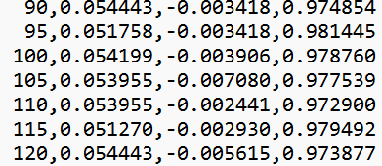
🪒Embedded Programming
2 Programming – TASK 2 Complete the Sensing Function
Step 1: Navigate to the ‘src’ folder, double click the ‘sensing.cpp’, go the the ‘sensing_sample_once’.
Step 2: Complete the part marked in red
Use the function from mpu6050.hpp/cpp to get ax ay az (raw data)
Convert the data with unit of ‘g’ & calibrate the data by ‘cali_scale_x/ cali_scale_y/ cali_scale_z’. Refer to config.hpp/cpp. Hint: the sensor range is 2g, and the resolution is 16 bit.

Slide 37

🪒Embedded Programming
2 Programming – TASK 2 Complete the Sensing Function

Slide 38
🪒Embedded Programming
2 Programming – TASK 2 Hints
The ‘sensing_sample_once’: Variables ax, ay, az are already created. We need to find the function to read the data from the mpu6050. Please check mpu6050.hpp and mpu6050.cpp to find one useful function to do this.
The mpu6050 range is by default 2g, also for this project. Variables, ax, ay, az, stand for raw data. But we need to convert the data from raw data to data with unit of g. Also, we want to calibrate the sensing. Hint: the range is by dault 2g, and we need to convert the data into values with unit of g. ax_g, ay_g, az_g = scalefactors * (raw value)/(2^(16)/4) = scalefactors * (raw value)/2^(14) . Note scalefactors are defined in config.hpp/cpp.

Slide 39

🪒Embedded Programming
2 Programming – Compile and Upload Code
1. Build and upload code for the main node
Ensure you finished the tasks in previous slides
Click the build button, wait for the build to succeed
Connect one sensor node to your computer via USB, click the upload button, and wait for the upload to finish
2. Testing
Launch the Serial Monitor (baud reate 115200) to check the output. Press reset for rebooting after building up the serial connection.
Check the RGBLED for debugging:
white for a long time – booting error; red – error; light blue – rf communication; blue – wifi communication; green – idle/ready; yellow – preparing for sensing; purple - sensing.
compile
upload

Slide 40

🪒Embedded Programming
Suggested Answer
2^16
2^14=16384
- 2g
- g
0
g
2g

Slide 41

🪒Indoor Vibration Test (ZS1107)
Task:
1) Deploy wireless sensors on the beam and obtain the vibration accelerations 100Hz 30s
2) Plot the time history data and PSD. Calibrate the scaling factor for each axis.
Excited by the hamper at the end (Tap gently to avoid exceeding the range 2g for Arduino node)
2~3 sets
Sensor
Cantilever Beam

Slide 42

🪒Outdoor Vibration Test (TBD)
Task:
1) Deploy wireless sensors on the footbridge and obtain the vibration accelerations
2) Identify modal parameters leveraging the obtained vibration signal
Sensor
Excited by 1) jumping near the midspan and 2) the environment
Each for 3 sets
Footbridge

Slide 43
Lab Experiment Course
Thank you for your attention
Q&A
Yuguang Fu
Nanyang Technological University
29-July, 14:00 - 17:15 @ TU103 & ZS1107

